Slide 1



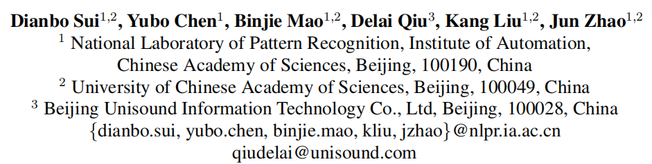

Chongqing University of Technology
ATAI
Advanced Technique of Artificial Intelligence
Chongqing University of Technology
EMNLP2020_Knowledge Guided Metric Learning for Few-Shot Text Classification
Reported by Ting Wang
2021.01.31 • BeiJing

Slide 2

Chongqing University of Technology
ATAI
Advanced Technique of Artificial Intelligence
Chongqing University of Technology
1. Introduction
2. Innovation
3. Method
4. Experiments
5. Conclusion

Slide 3





Introduction
Query set
Support set
meta task1:
meta-training:
meta task2:
meta task3:
meta parameter
meta task4:
meta-testing:
meta task5:
Notes:
f

Slide 4
Innovation
1. Inspired by human intelligence, we present the first approach that introduces external knowledge into few-shot learning.
2. A novel parameter generator network based on external knowledge is proposed to generate diverse metrics for diverse tasks.

Slide 5
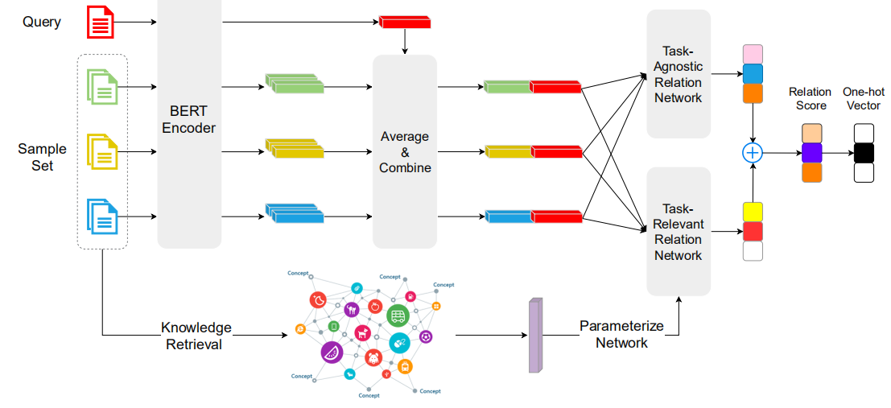
Approach
1.Embedding module
2.Relation module

Slide 6
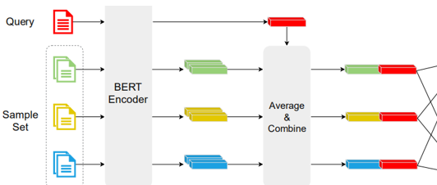


Approach
input text：
(1)
C_{z}
h(x_{j})
class representation:
(2)
h(x_{i}),h(x_{j})分别是support set表示和query set表示。
(3)

Slide 7



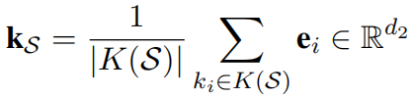


Approach
p_{z,j}
Task-Agnostic Relation Network:
f_{ϕ}和 g_{θ}都是MLP
relation scores:
is learnable parameters
Task-Relevant Relation Network:
knowledge representation:
e_{i} is entity embedding
（5）
meta parameter:
is learnable parameters
（6）
relation scores:
（7）

Slide 8
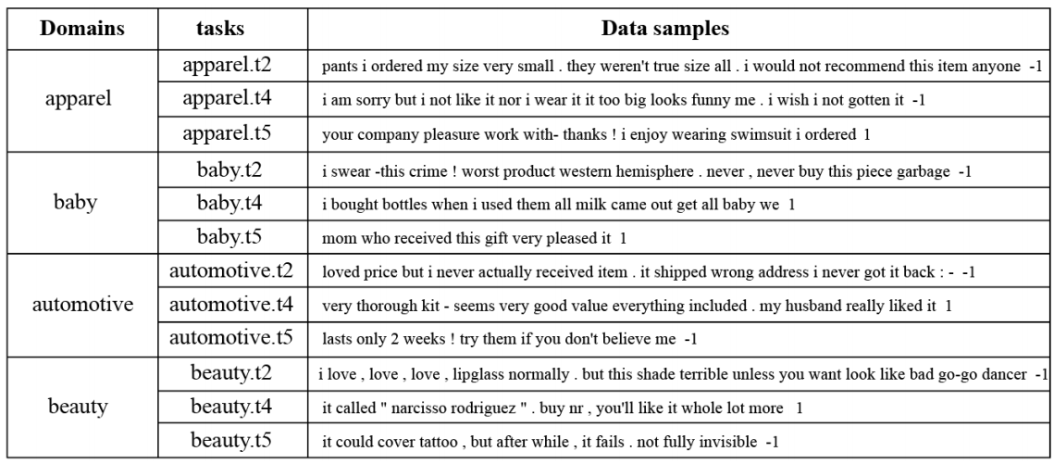
Experiments
亚马逊评论情感分类（ARSC）数据集：
Dataset：
https://github.com/zxlzr/FewShotNLP/tree/master/data

Slide 9
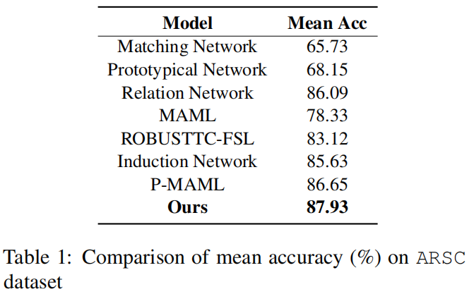
Experiments

Slide 10
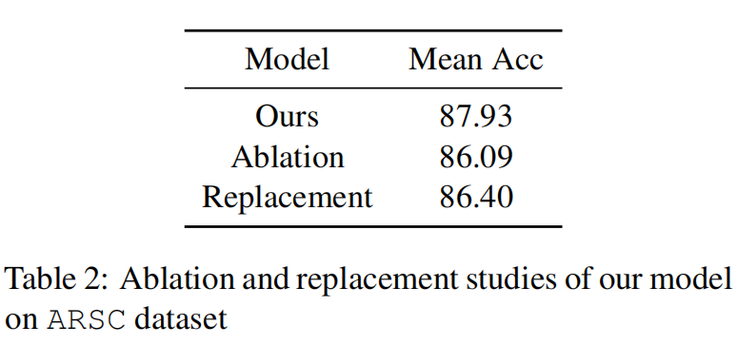
Experiments

Slide 11
Conclusion
Inspired by human intelligence, we introduce external knowledge into few-shot learning. A parameter generator network is investigated to this end,which can use external knowledge to generate relation network parameters. With these parameters,the relation network can handle diverse tasks with diverse metric. Through various experiments, we demonstrate that our model outperforms the current SOTA few-shot text classification models.

Slide 12
Thanks!

